Slide 1




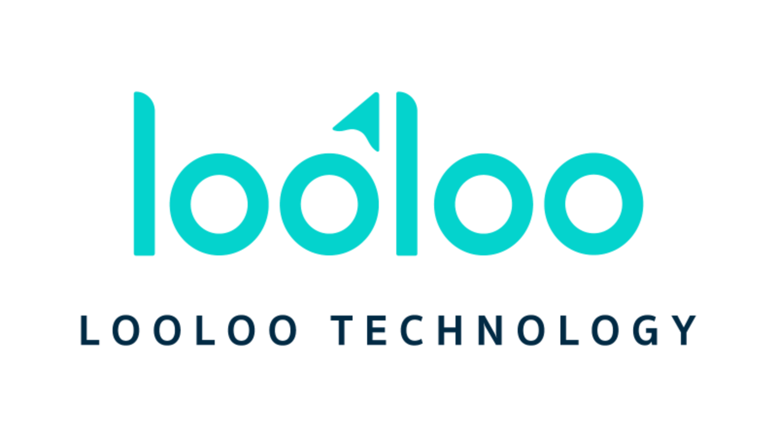







Introduction to
Basic Python Programming

Slide 2





Programming Language
Level of programming language
What is Python
Advantage & Disadvantage of Python
Python Applications
01
02
03
04
05

Slide 3

What is programming language?

Slide 4
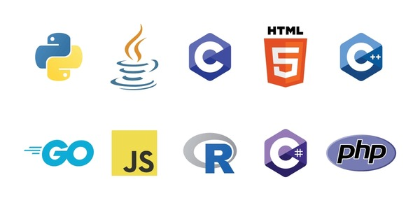
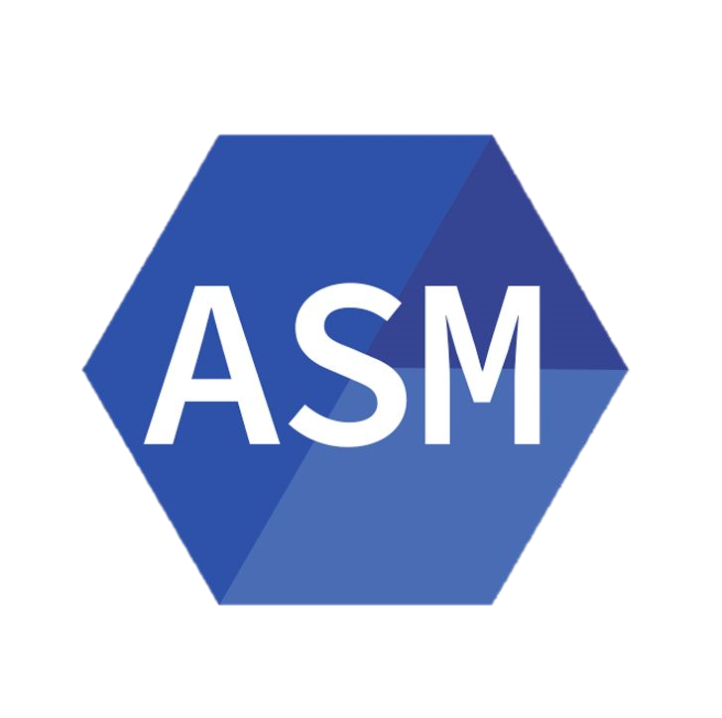
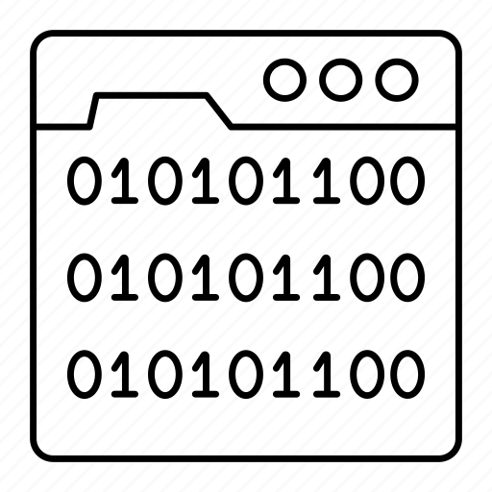
Level of programming language
High-Level Language
Assembly Language
Machine Language

Slide 5
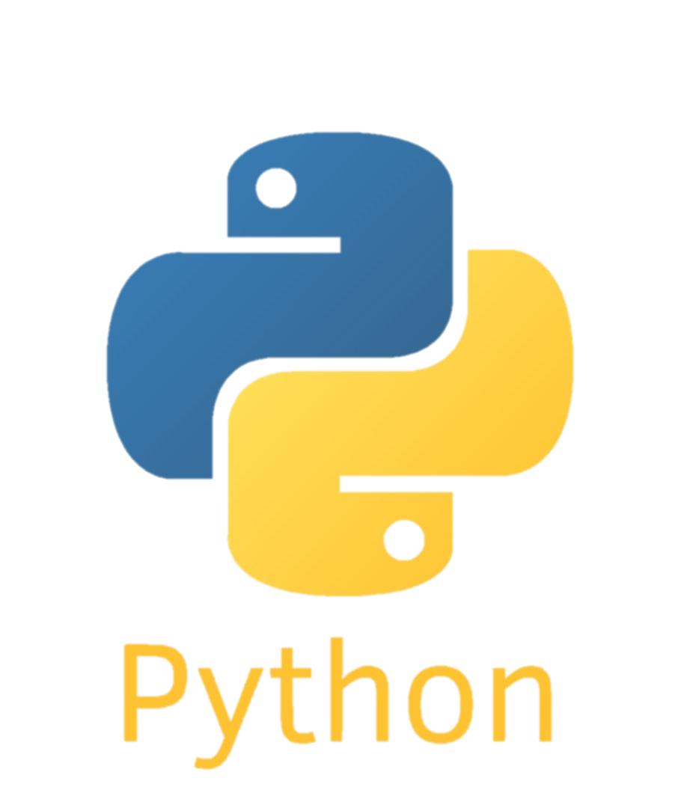
What is Python?

Slide 6
What is Python?
Python is an interpreted, object-oriented, high-level programming language with dynamic semantics. Its high-level built in data structures, combined with dynamic typing and dynamic binding, make it very attractive for Rapid Application Development, as well as for use as a scripting or glue language to connect existing components together. Python's simple, easy to learn syntax emphasizes readability and therefore reduces the cost of program maintenance. Python supports modules and packages, which encourages program modularity and code reuse. The Python interpreter and the extensive standard library are available in source or binary form without charge for all major platforms, and can be freely distributed. (www.python.org)

Slide 7
Pros & Cons
Advantage of Python
Beginner-friendly
Large Community
Flexible and Extensible
Portability
Disadvantage of Python
Slow Speed
Not Memory Efficient
Notes:
Flexible and Extensible
Python is extremely flexible and can be extended to other languages. Developers can write code in C and C++ and build new features in the dynamically-typed language.
Python is portable, which means it can be run on any other platform. Here, you need to code only once, and you can run it anywhere.

Slide 8
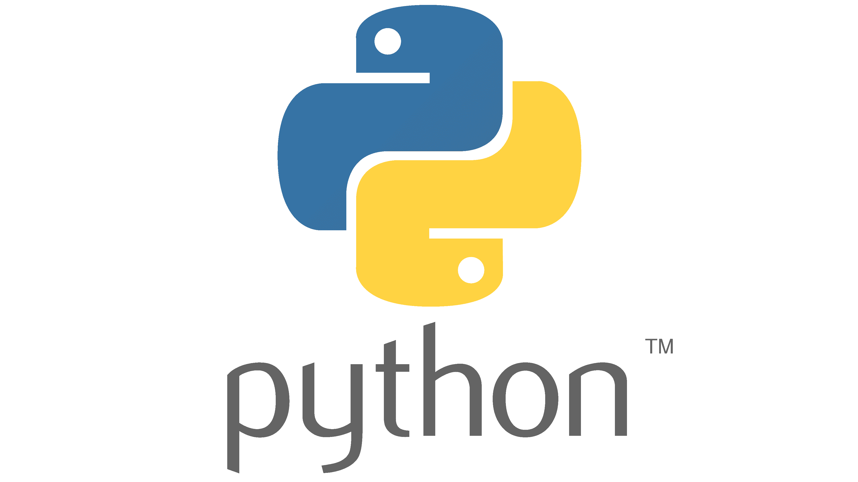
Python Application
AI & Machine Learning
Data Analytics
Web and Internet Development
Scientific and Numeric
Software Development
Desktop GUIs
Business Applications

Slide 9


Slide 10
THANK YOU
FOR ATTENTIONS

